Slide 1

All work and no…?
The imperative of play in the WL classroom
Dr. Lori Langer de Ramírez
Director, World and Classical Languages &
Global Language Initiatives, The Dalton School, NYC
lori@miscositas.com
Notes:
----- Meeting Notes (10/11/13 22:14) -----
----- Meeting Notes (10/11/13 22:24) -----
LOTE on the Cutting Edge: Meeting the Challenges of Increased Accountability

Slide 2
The challenge…
(an admission)

Slide 3


Slide 4
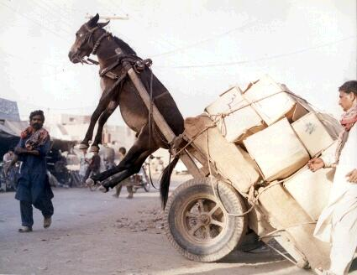

Slide 5


Slide 6
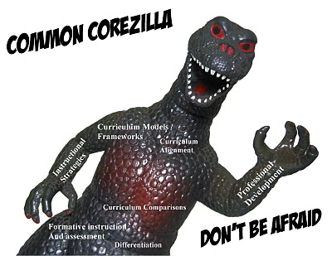

Slide 7
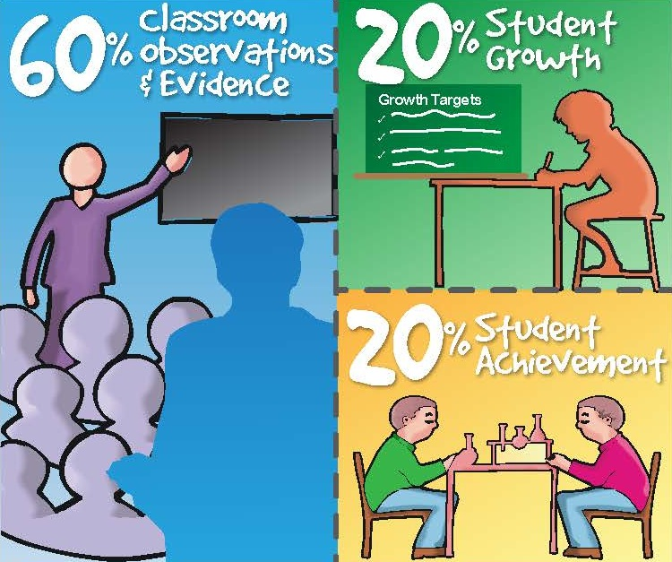
APPR

Slide 8


Slide 9
What to do…?

Slide 10

1. Motivational memes
therapy!

Slide 11


Slide 12


Slide 13


Slide 14


Slide 15


Slide 16
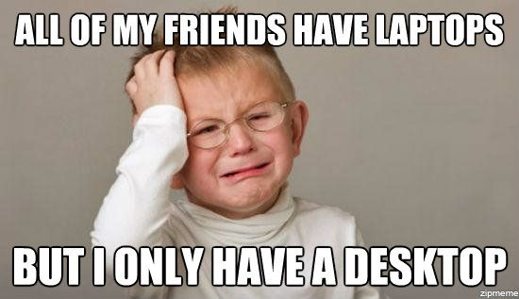
2. Put things into perspective

Slide 17
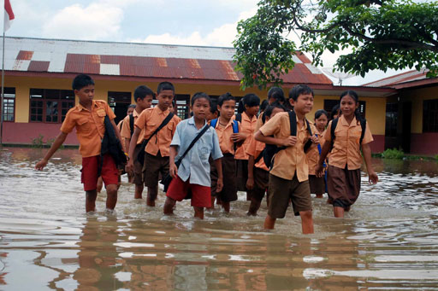

Slide 18
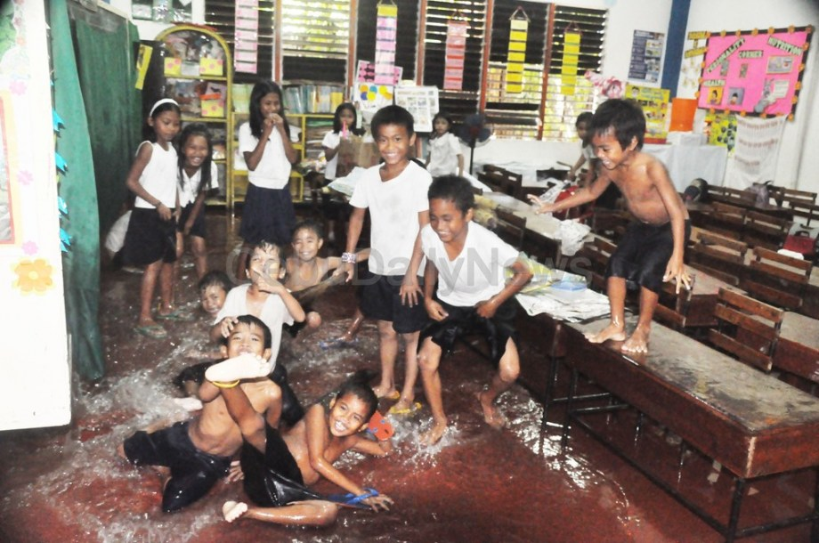

Slide 19

3. Coffee, chocolate, red wine
Notes:
----- Meeting Notes (10/11/13 22:24) -----
substance abuse!
chemical fix - limit intake?

Slide 20
4.
juca
Играть
遊ぶ
เล่น
لعب
खेल
jouer
PLAY!
spielen
jogar
giocare
spela
놀이
玩
jugar
לשחק
maglaro

Slide 21
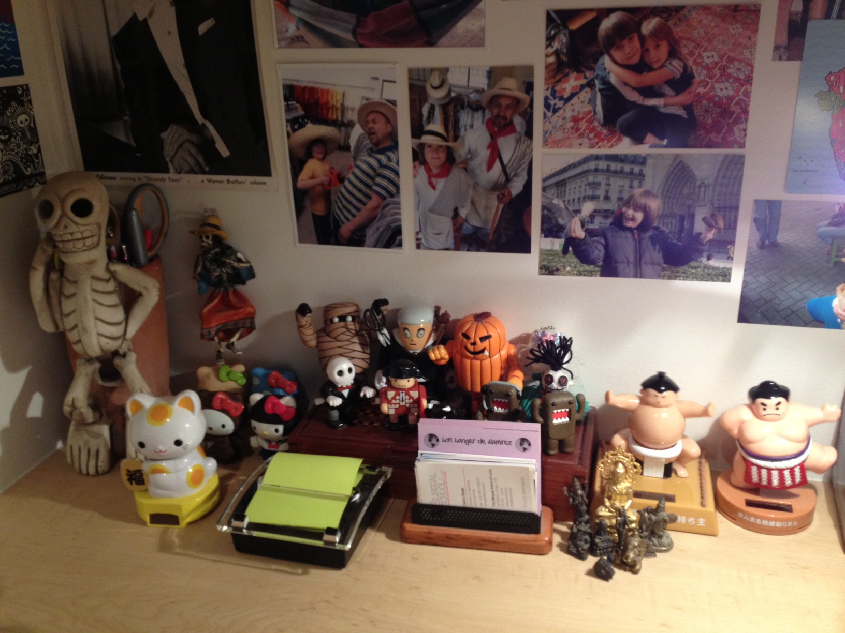

Slide 22
Manipulatives:
* toys
* fake food
* musical instruments
* animals
* transportation
* lot of STUFF!

Slide 23
Why play?
(convince me…)

Slide 24
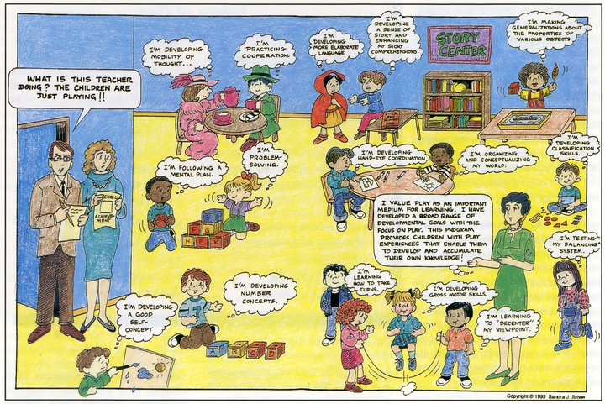
Notes:
----- Meeting Notes (10/11/13 22:24) -----
other teachers comment that lang teachers are always eating and singing

Slide 25
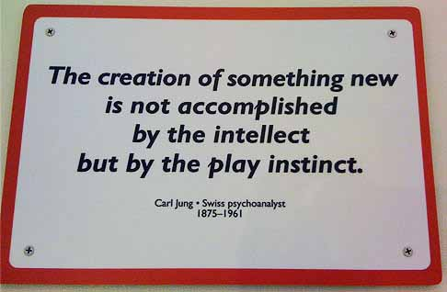

Slide 26
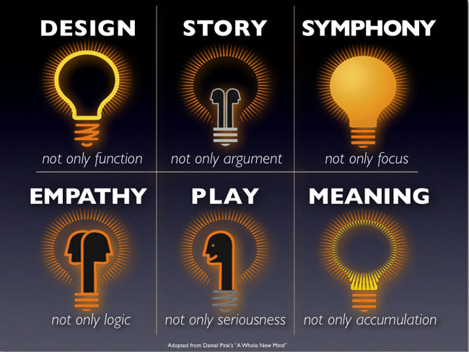
Notes:
----- Meeting Notes (10/11/13 22:49) -----
six essential aptitudes on which professional success and personal fulfillment will depend in the 21st century

Slide 27


games
humor
joyfulness
Notes:
----- Meeting Notes (10/11/13 22:49) -----
power dynamics - folks with less power will acclimate to the tenor/vibe/tone of the person in the room with the most power --> joyfulness!

Slide 28
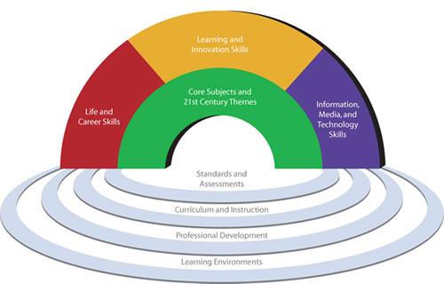
The Partnership for 21st Century Skills
www.p21.org

Slide 29

Learning and Innovation Skills:
A focus on creativity, critical thinking, communication and collaboration
is essential to prepare
students for the future.
→ Creativity and Innovation
Think Creatively
Work Creatively with Others Implement Innovations
→ Critical Thinking & Problem Solving
Reason Effectively
Use Systems Thinking
Make Judgments and Decisions
Solve Problems
Communication and Collaboration
Communicate Clearly
Collaborate with Others

Slide 30
Play can be an ideal vehicle for language acquisition
for a number of reasons (Sachs, 1984):
Since play is not goal oriented, it removes pressure and frustration from the interactive process. It's fun.
Attention and the semantic domain are shared by the interactive partners, so topics are shared.
Games have reciprocal role structure and variations in the order of elements, as do grammars.
Games, like conversations, contain turn-taking.

Slide 31

School is Broken?
(Games) offer up carefully designed pleasures, thrilling challenges and powerful social bonding afforded by virtual environments.”
“From zero to peak experience in thirty seconds flat – no wonder video games caught on. Never before in human history could this kind of optimal, emotional activation be accessed so cheaply, so reliably, so quickly.”
“Games challenge us with voluntary obstacles and help us put our personal strengths to better use.”
“Games make us part of something bigger and give epic meaning to our actions.”

Slide 32
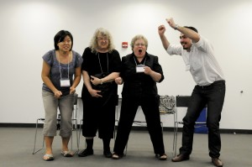
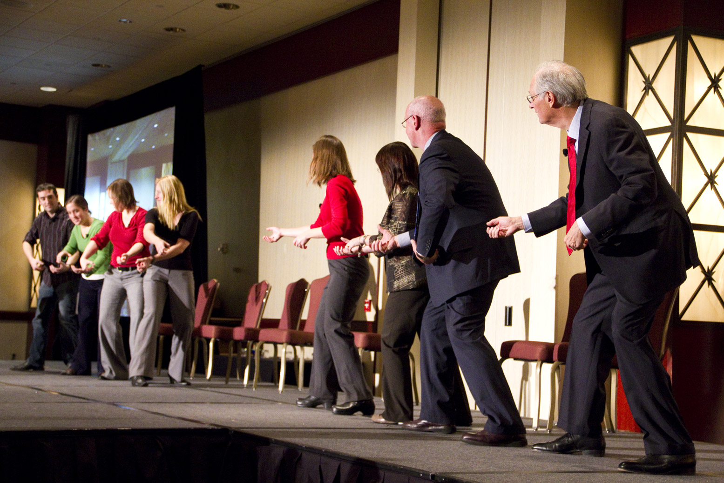

PD? The Center for Communicating Science, Stonybrook University

Slide 33


Slide 34
What does play look like
in the language classroom?

Slide 35

Gamification!

Slide 36
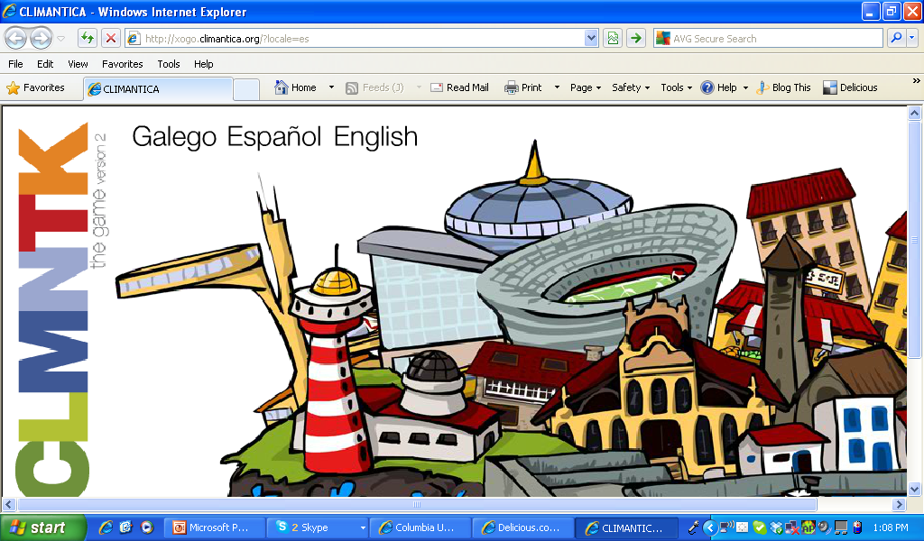

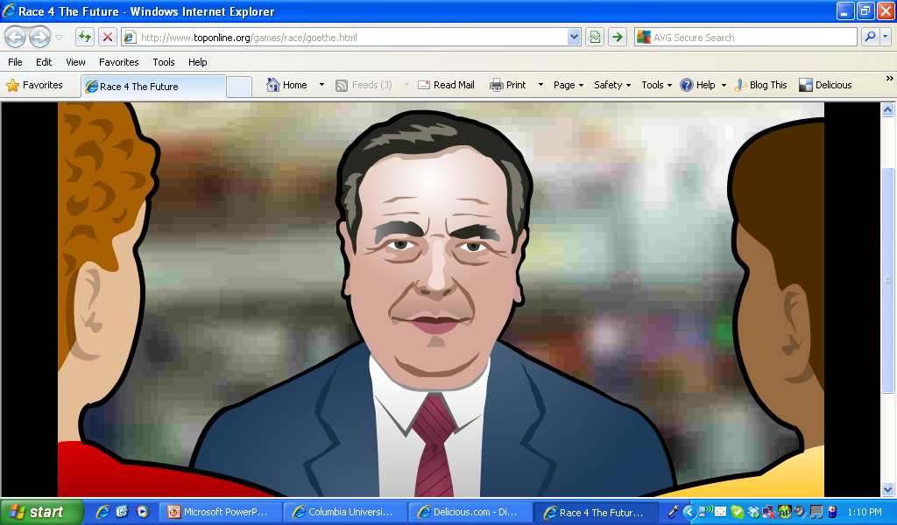
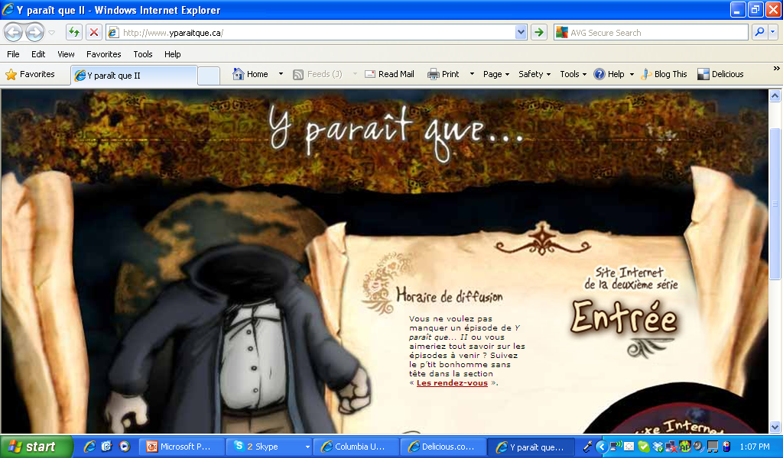
Features of games
goals
rules and obstacles
feedback systems
voluntary participation

Slide 37
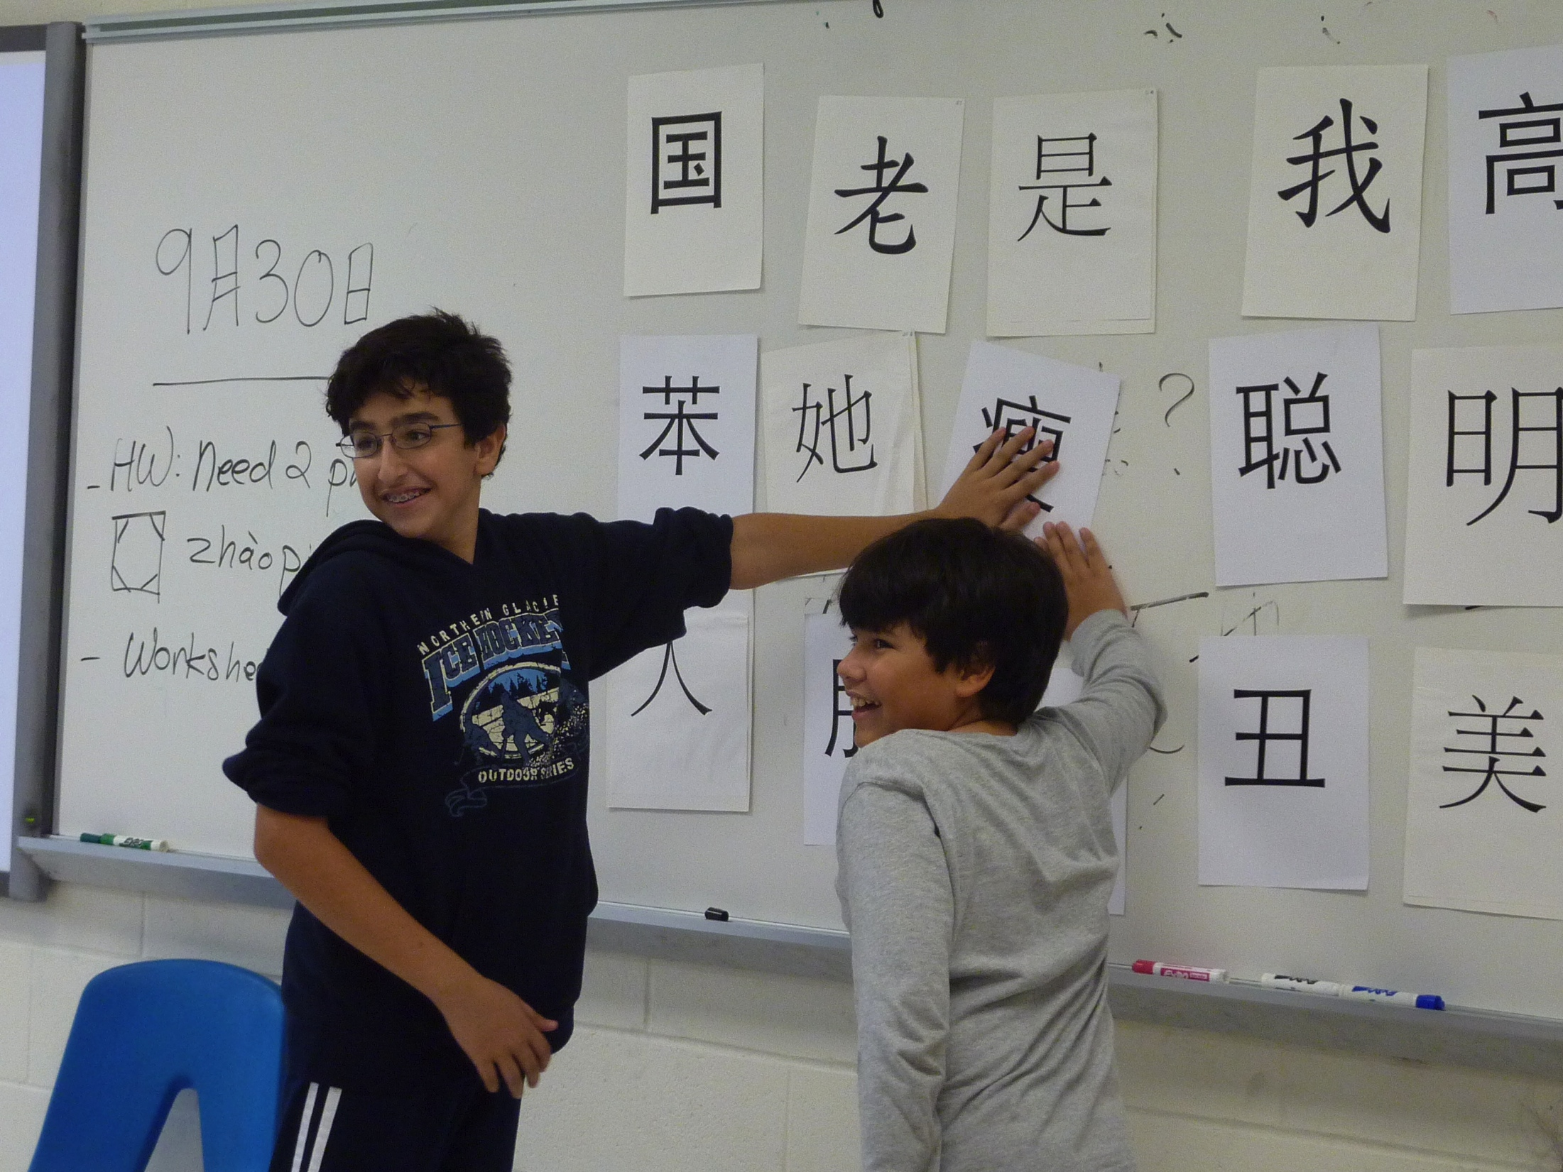
hands-on
kinesthetic
repetition

Slide 38
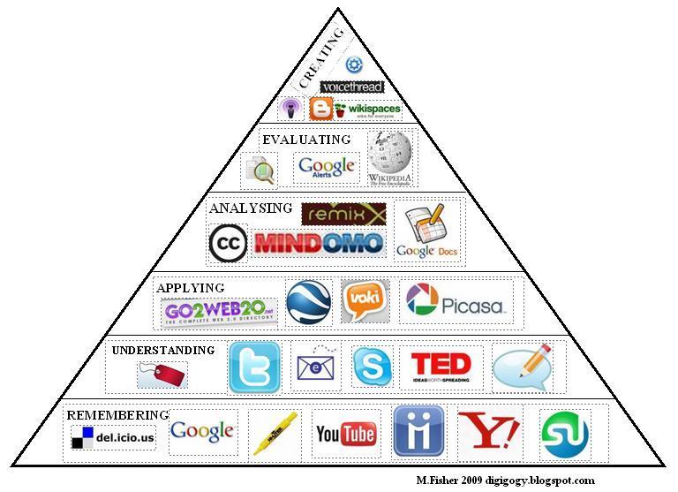
Blogs
Podcasts
Wikis
Social Networks
Social Bookmarking
YouTube.com
VoiceThread.com
Issuu.com
Voki.com
Web 2.0 tools
An overview of Webtools:
www.miscositas.com/webtools
Notes:
----- Meeting Notes (10/11/13 22:49) -----
by the way, kids are already playing with these tools - why not leverage their popularity - and fun - to teach languages?

Slide 39

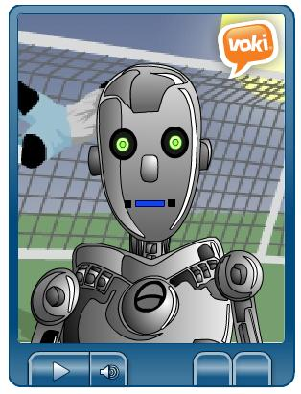
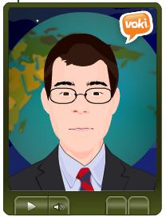
Digital dress-up | Voki.com avatars
Notes:
----- Meeting Notes (10/11/13 22:49) -----
game for you: two of these vokis were made by students, one by a teacher-colleague… can you guess which was made by a teacher?

Slide 40
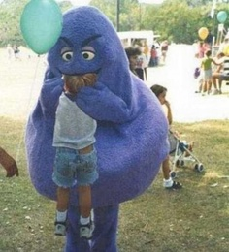
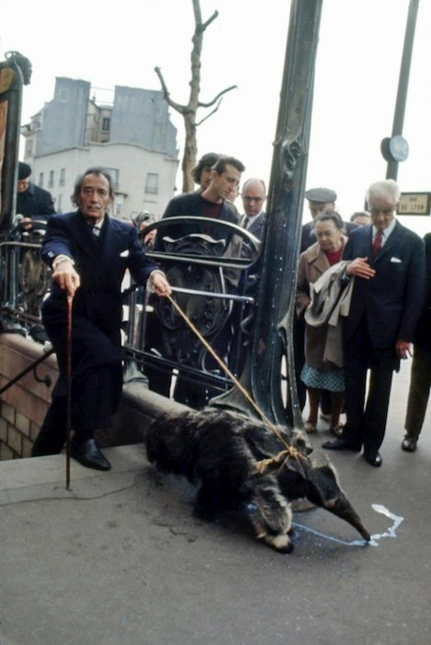
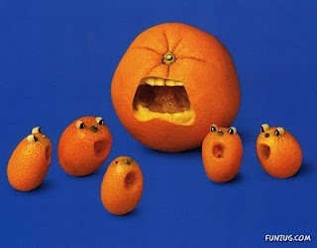
Speaking and writing prompts

Slide 41
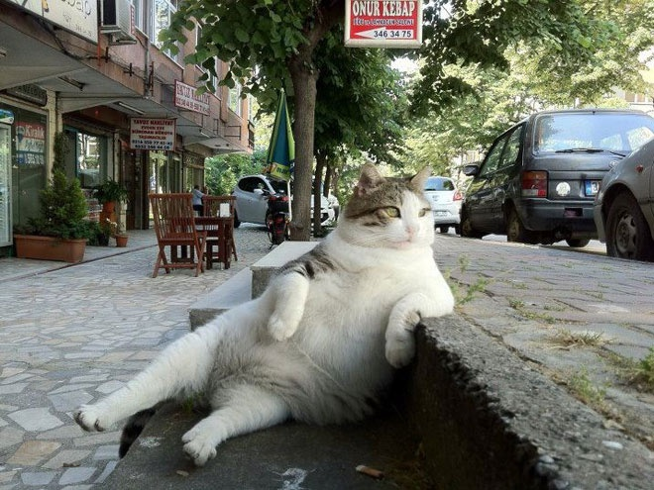
Speaking and writing prompts
Notes:
----- Meeting Notes (10/11/13 22:49) -----
gets students to be playful with language

Slide 42
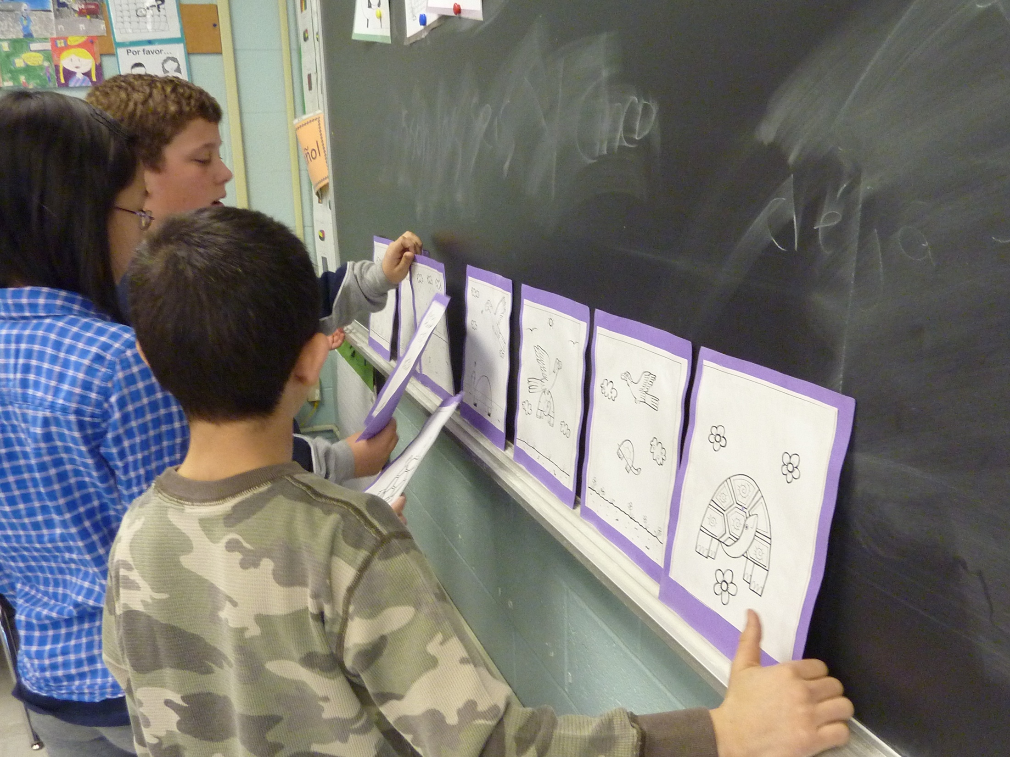
Folktales | story mapping

Slide 43
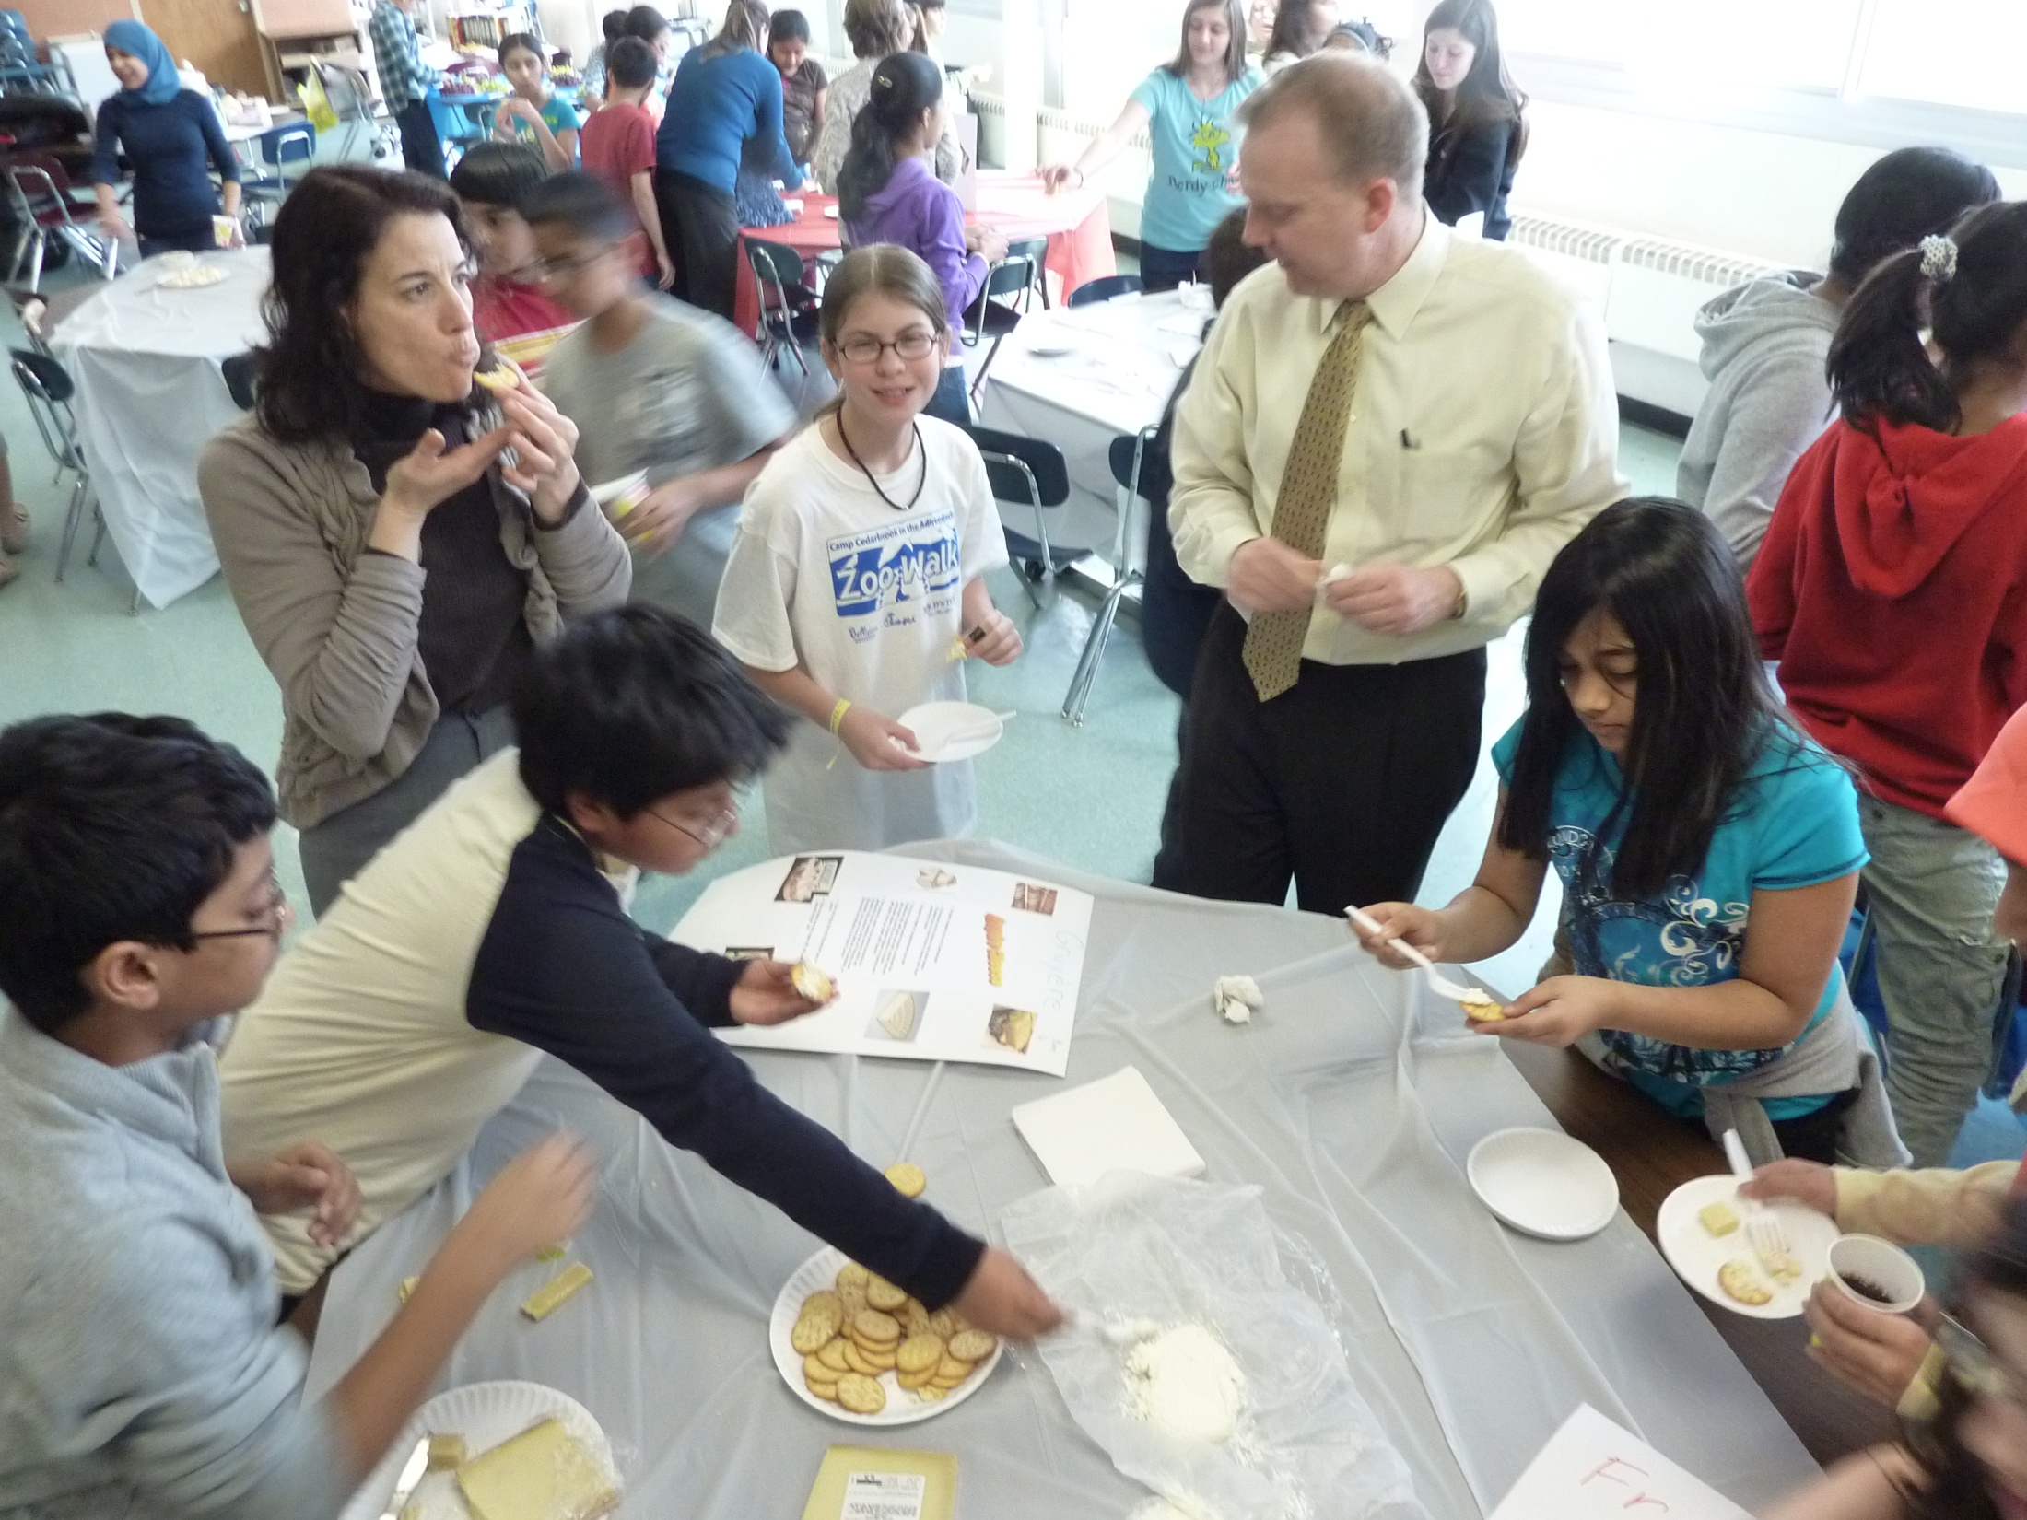
Food tasting | cheese making

Slide 44
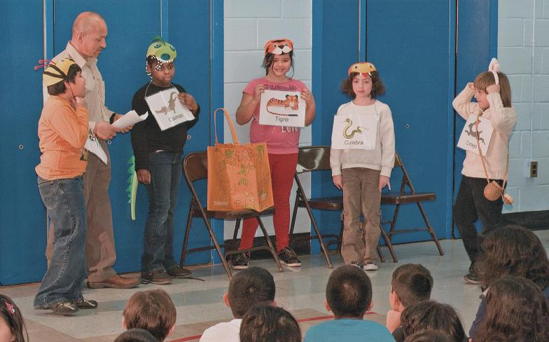
Role-playing
Skits * TPRS * Videos * Puppet Shows

Slide 45
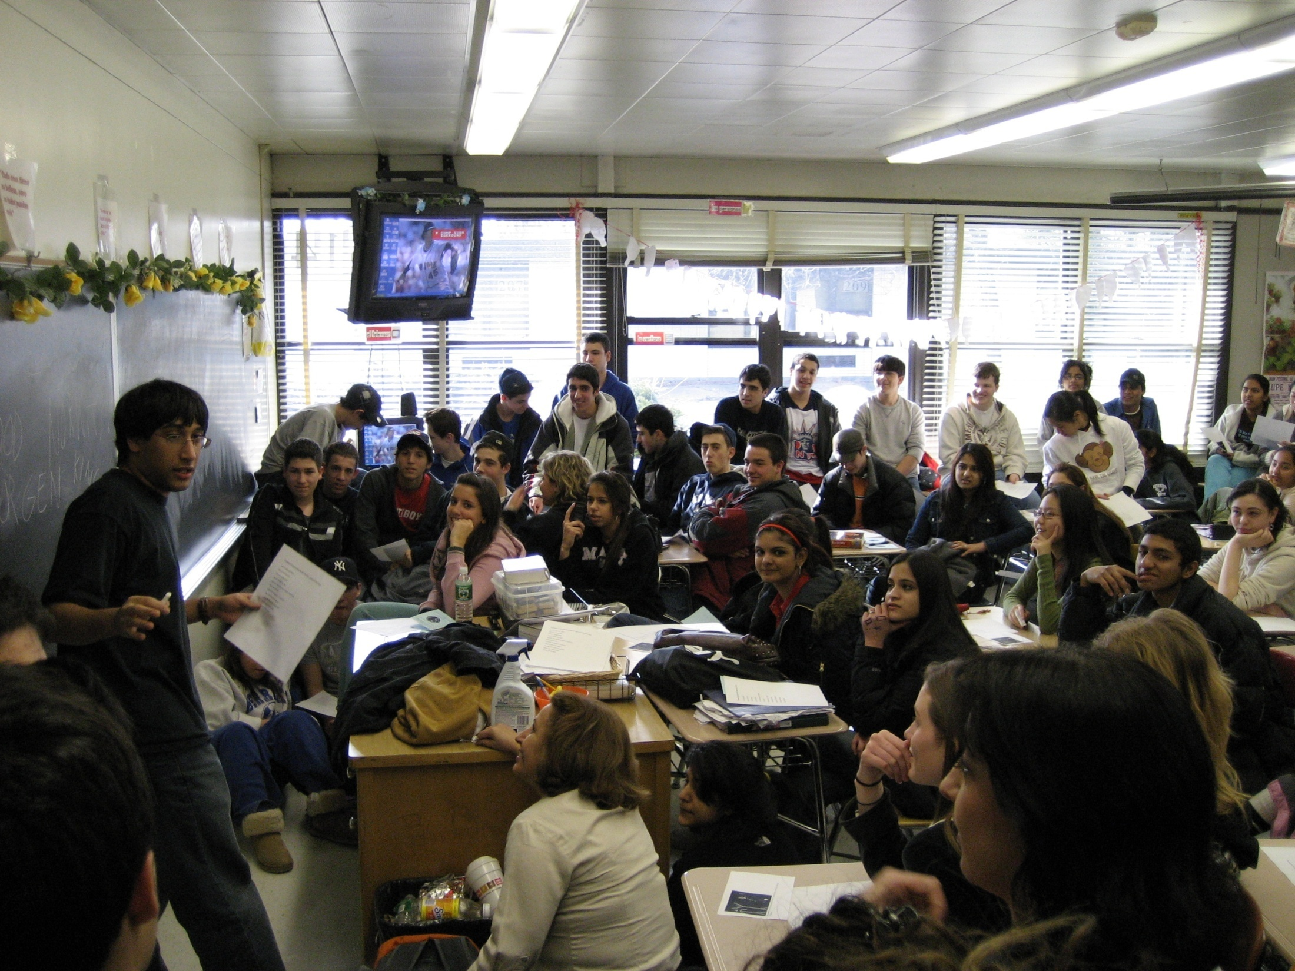
Playing school | Student-run language classes

Slide 46
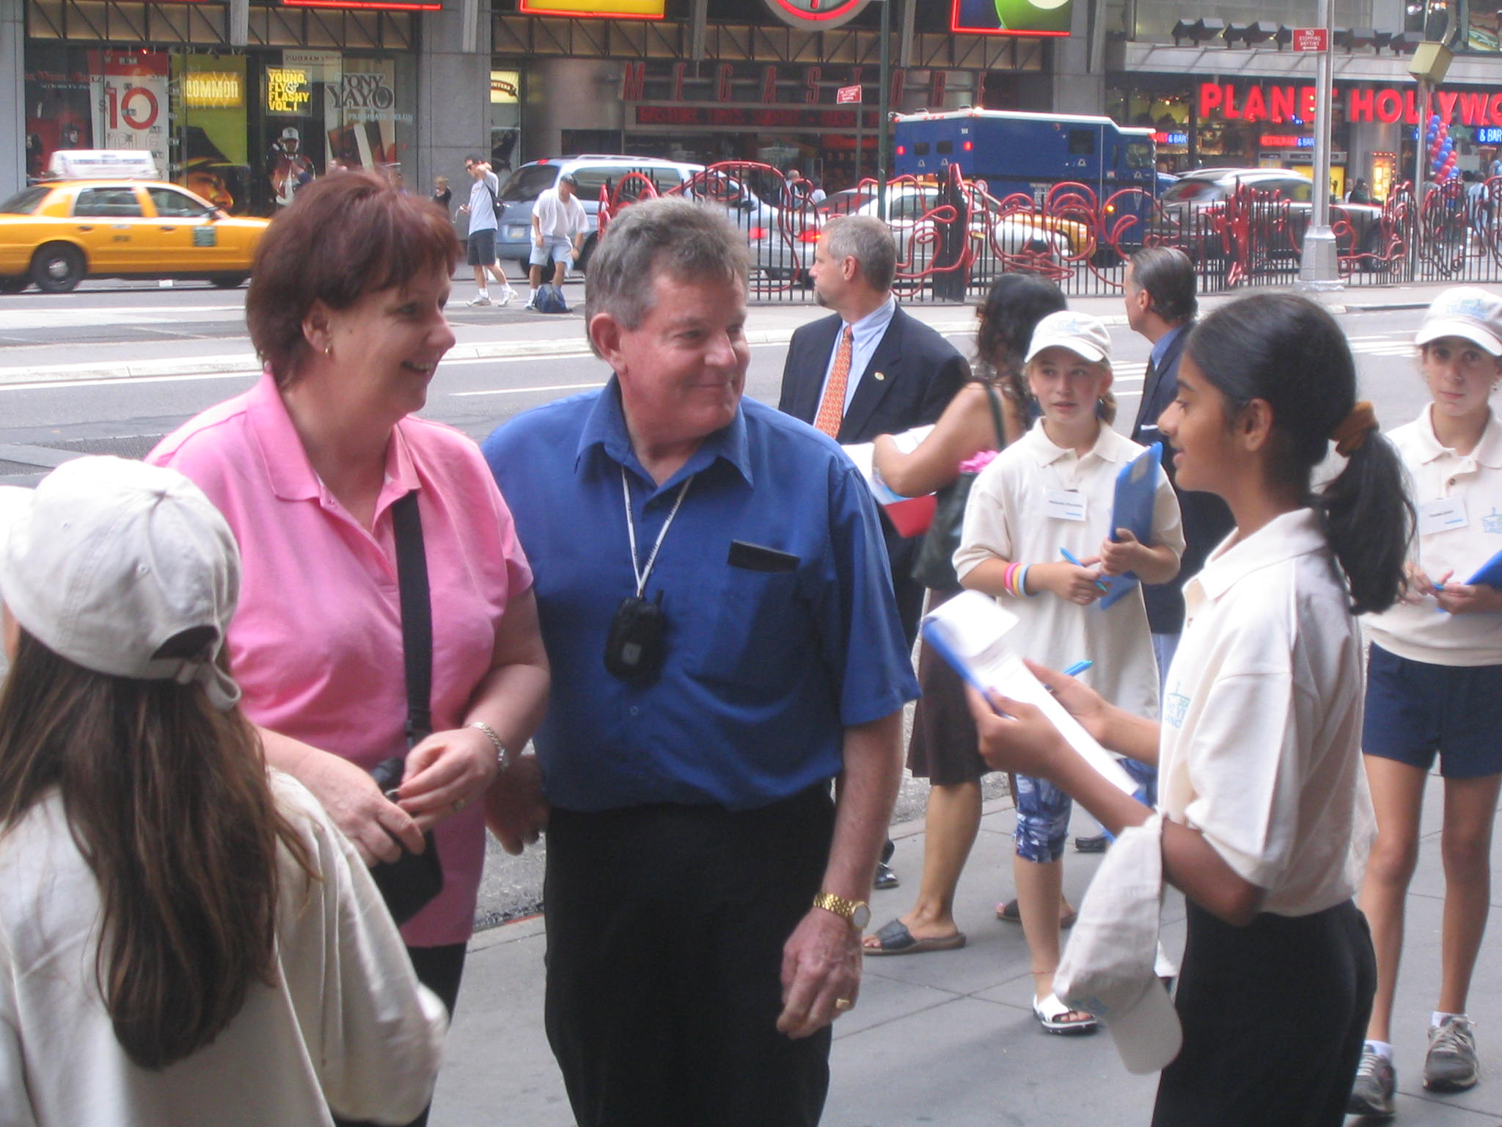
Playing researcher | Language ambush
Notes:
----- Meeting Notes (10/11/13 22:49) -----
students as researchers and activists

Slide 47
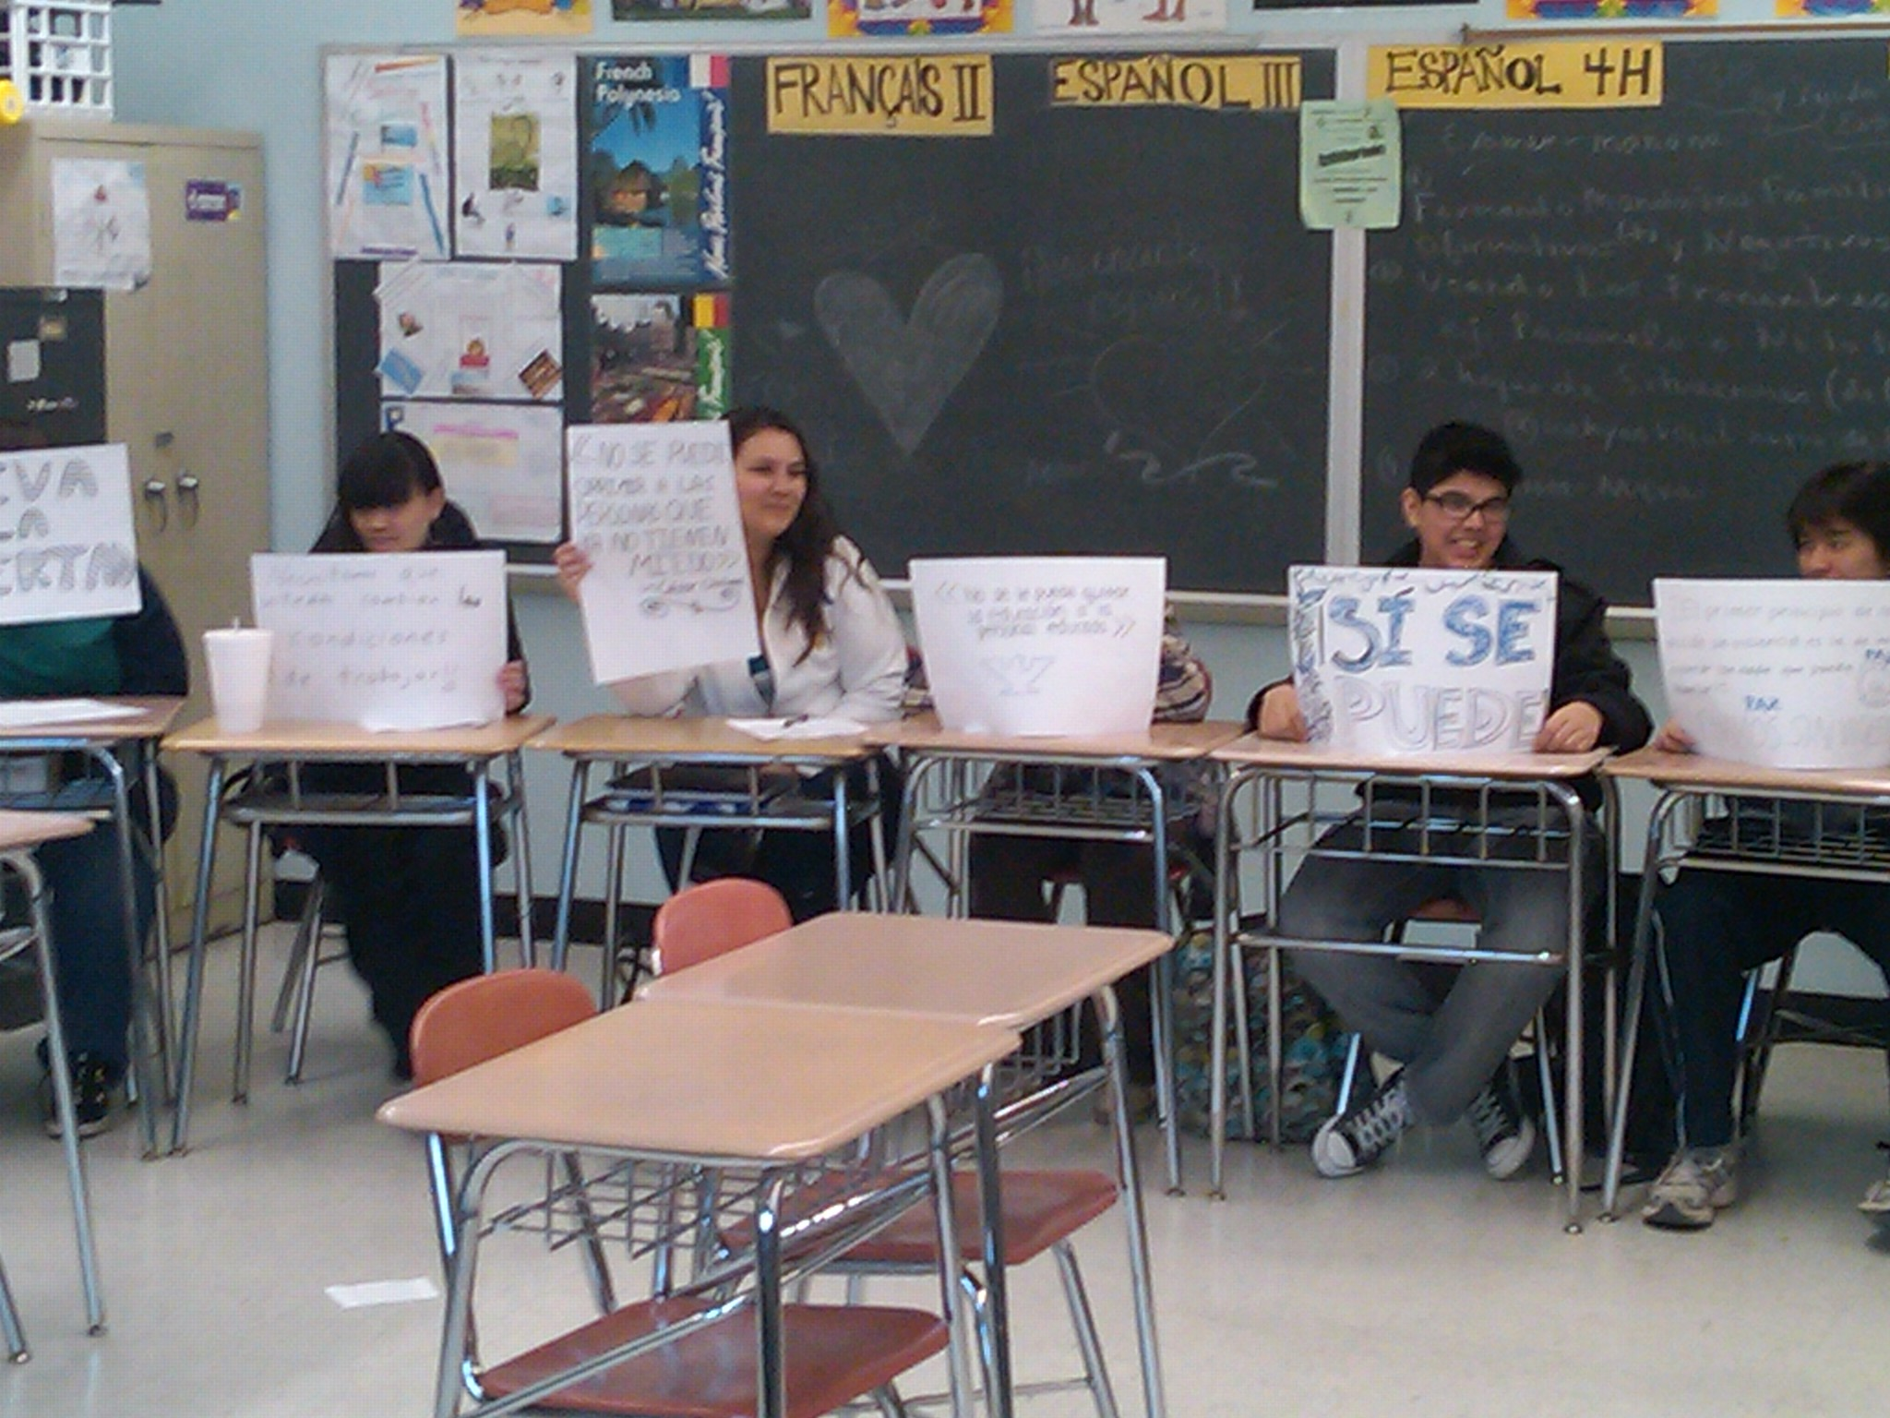
Simulations
Farmworkers protest

Slide 48
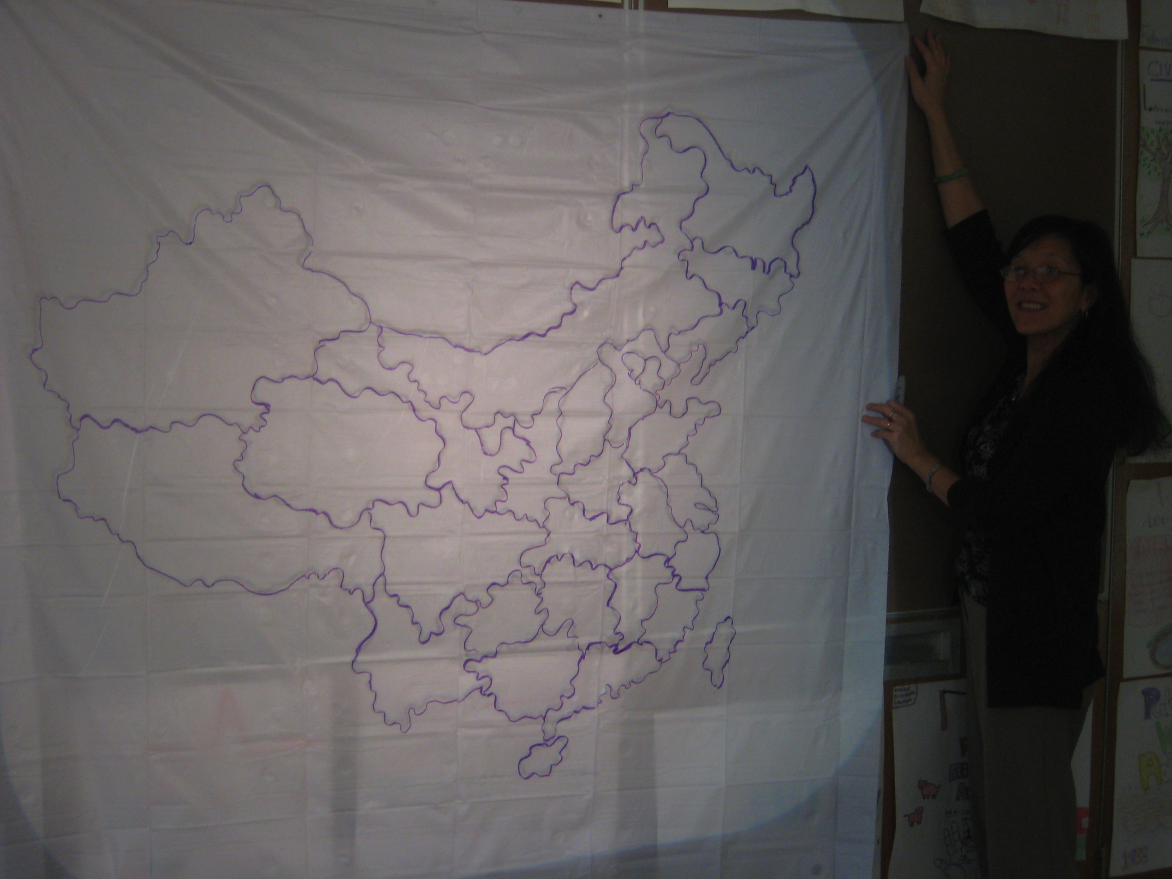
Play “old favorites”
Create a floor map/
Twister game

Slide 49
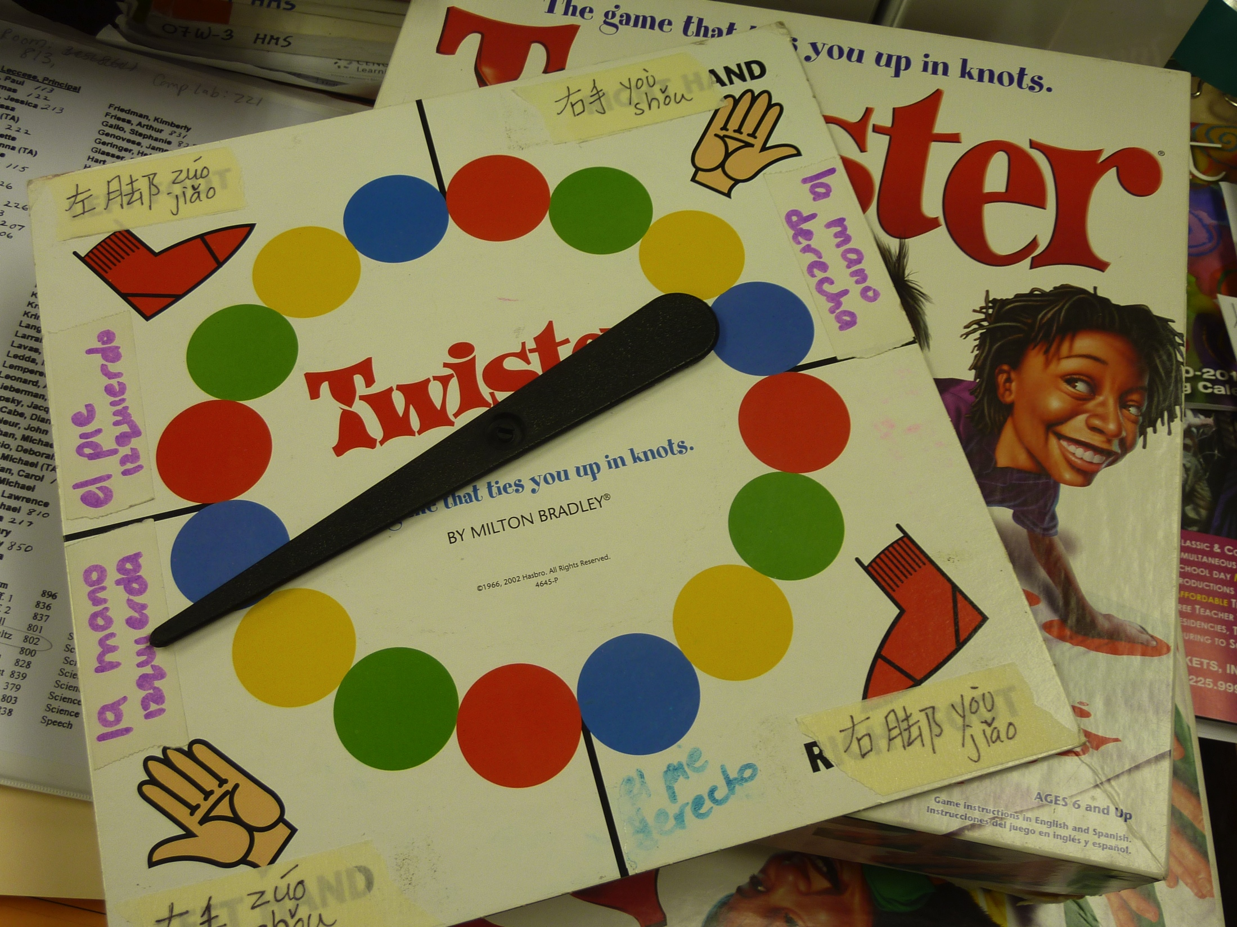

Slide 50
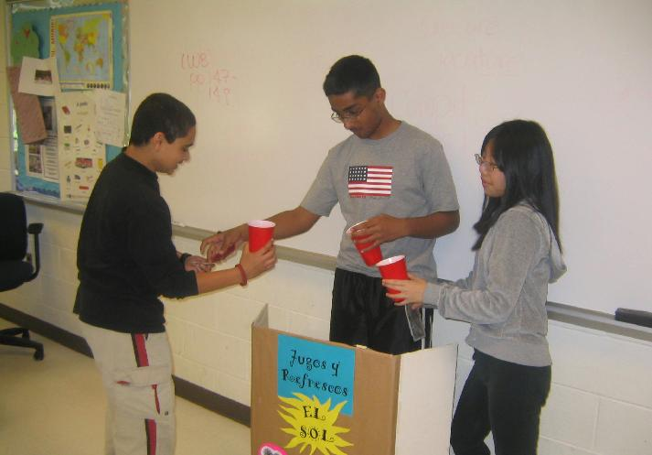
Take a
“fantasy trip”!

Slide 51

Take a trip to anywhere!
neighborhoods
cities, countries, regions
stores and businesses
markets
restaurants
museums and galleries
concerts and shows
schools
epals’ homes
parks and beaches

Slide 52
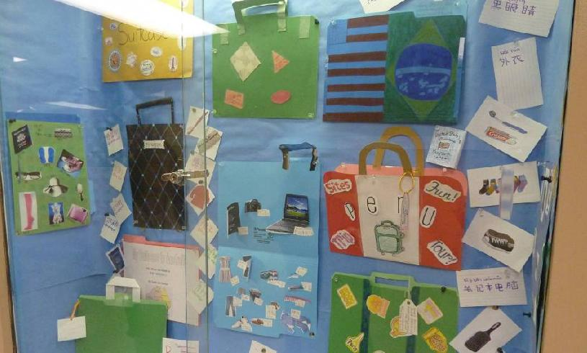
Pack your suitcase!

Slide 53
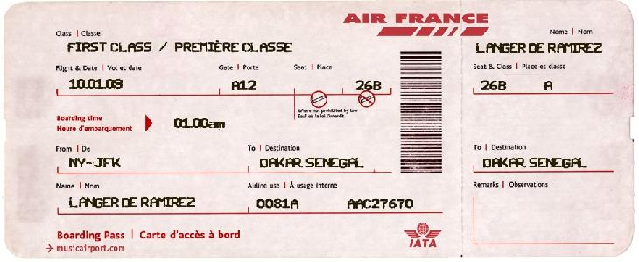
Don’t forget your boarding pass! omatic.musicairport.com

Slide 54

Be subversive…
Notes:
----- Meeting Notes (10/11/13 22:49) -----
so when you face challenges, I encourage you to first of all, be subversive!

Slide 55
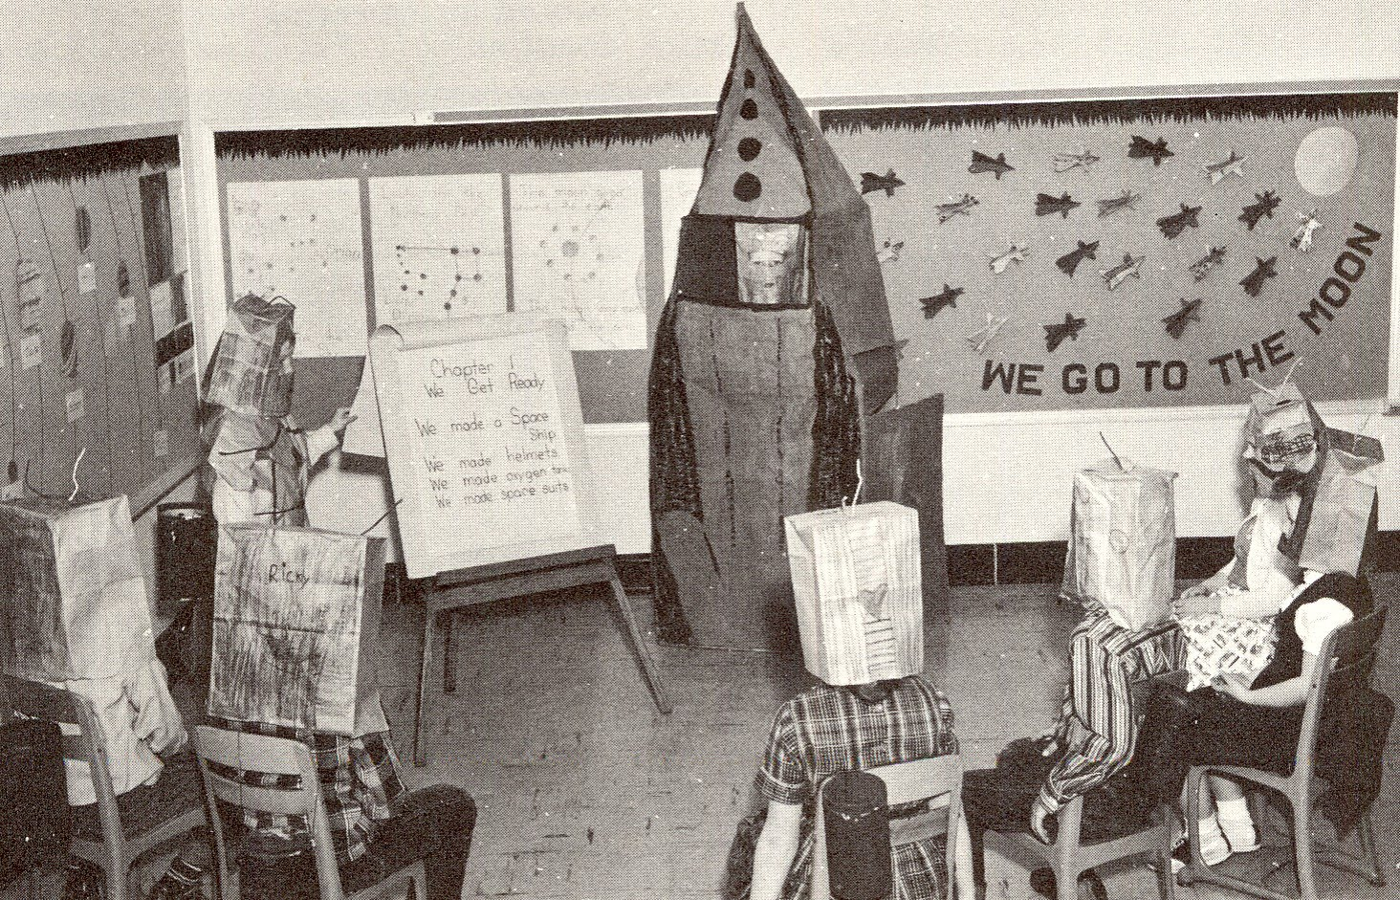
play…

Slide 56

and…

Slide 57
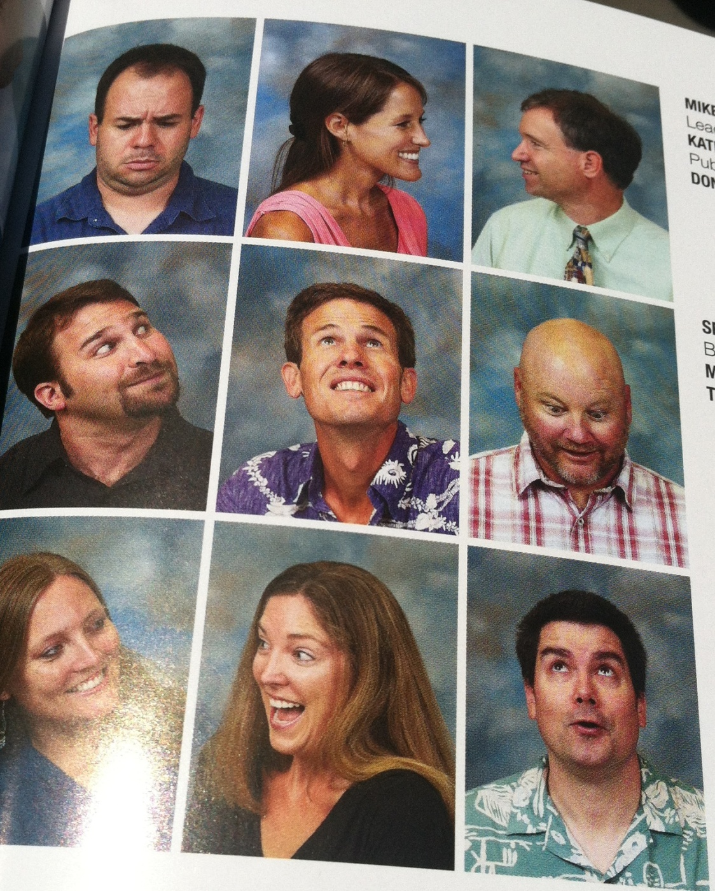
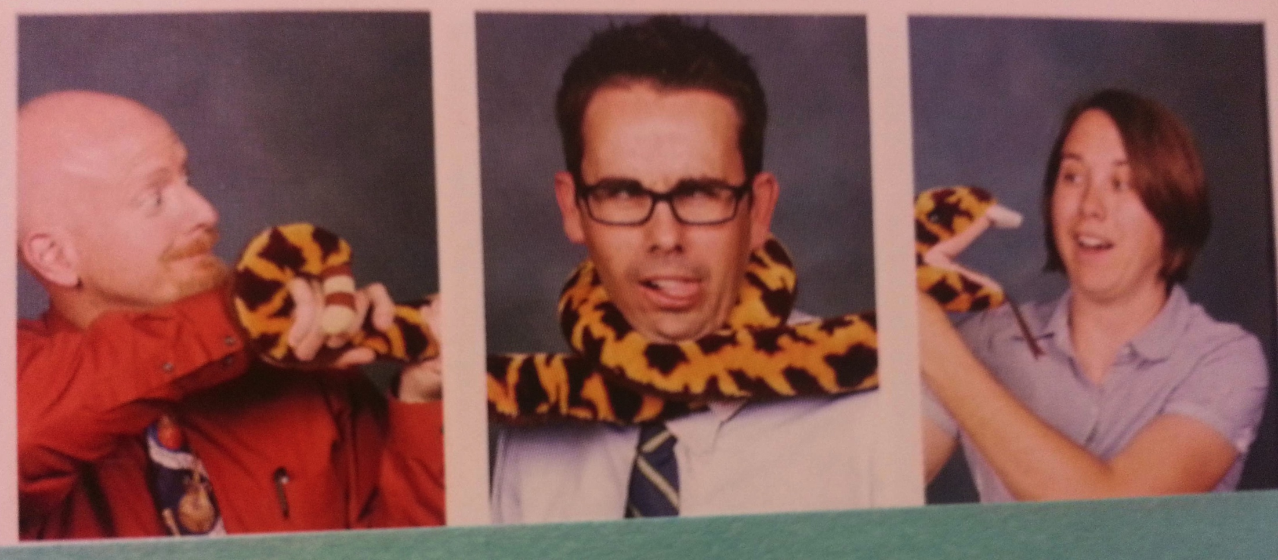
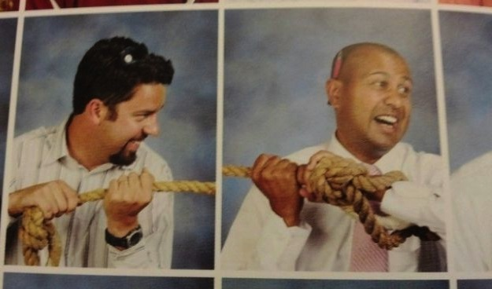
and…

Slide 58

Questions? Comments?
lori@miscositas.com

